Slide 1

Argumentative Essay

Slide 2
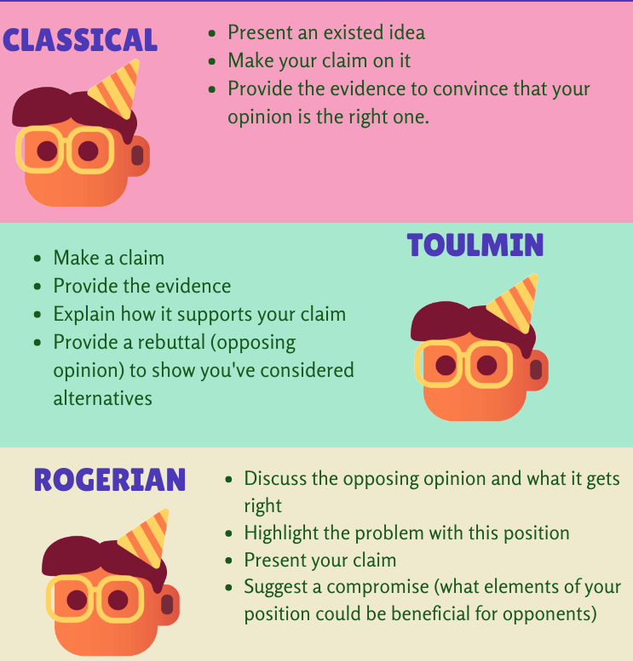
Argumentative essay….
also known as
persuasive essays
opinion essays
position papers
the author adopts a position on a debatable issue and uses reason and evidence to convince the reader of his/her opinion.
A good argumentative essay will use facts and evidence to support the argument, rather than just the author’s thoughts and opinions.
Notes:
3 models for presenting arguments
Classical (Aristotelian) arguments: Present an existed idea -> Make your claim on it -> Provide the evidence to convince that your opinion is the right one.
Toulmin arguments: Make a claim -> Provide the evidence -> Explain how it supports your claim -> Provide a rebuttal (opposing opinion) to show you’ve considered alternatives
Rogerian arguments: Discuss the opposing opinion and what it gets right -> Highlight the problem with this position -> Present your claim -> Suggest a compromise (what elements of your position could be beneficial for opponents)

Slide 3
Elements of a Convincing Argument
“Ethos” Authoritative voice
What makes you a qualified writer on the topic?
Draw from expertise of other credible sources, or personal experience
Ex: “You know me - I've taught Sunday School at your church for years, babysat your children, and served as a playground director for many summers - so you know I can run your preschool.”
“Logos” Appeal to reason,
Where logical statements come into play
reader is lead to agree as conclusions/implications follow reasonably from premises
Ex: “After years of disrespect from your boss, countless hours wasted, birthdays missed… it's time you took a stand.”
“Pathos” Appeal to audience,
misunderstood as emotional appeal, but is finding common ground with the reader
appeal to ethical, humanist ideals, assuming the audience is a generally ethical crowd
Ex: “More than a 100 peer-reviewed studies conducted over the past decade, and none suggest that this is an effective treatment for hair loss.”

Slide 4
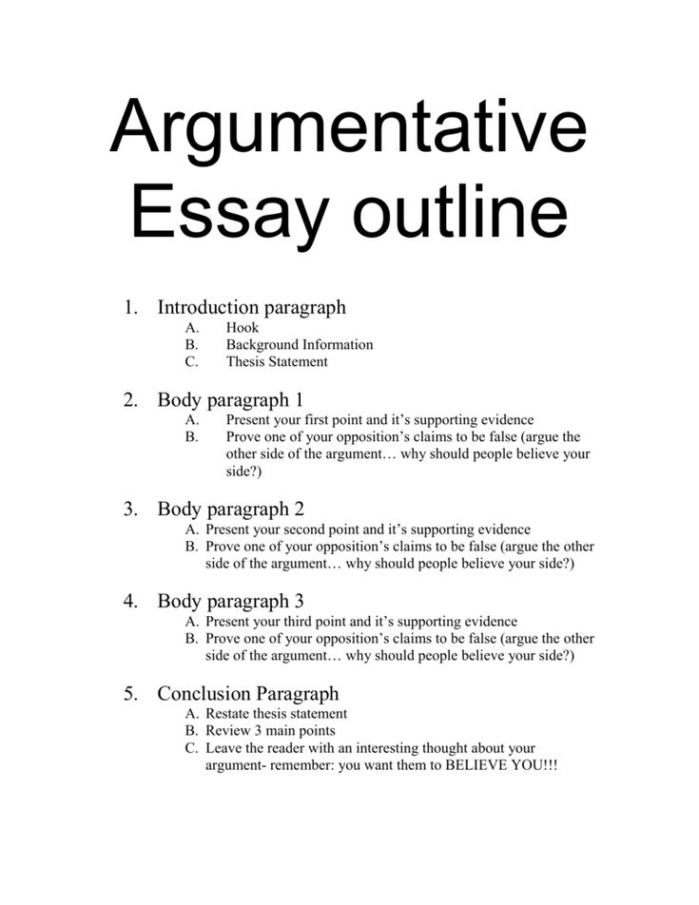
Structure: Argumentative essay
Introduction
provides some background information on topic
indicates that it is a controversial topic
ends with thesis statement
Thesis Statement
one sentence at the end of the introduction
states your opinion on the issue, often using “should” or “must”
lists reasons to support that opinion
may also mention the counter argument (i.e. opposite opinion):
Uses words like
Although; while; despite the fact that; However
to distinguish it from your opinion.

Slide 5
Examples
Some Canadians may think that the death penalty is an appropriate punishment;
COUNTER ARGUMENT
however, it shouldn’t be allowed because it is inhumane and does not reduce crime.
AUTHOR’S OPINION REASON 1 REASON 2
Although the internet can spread misinformation, the internet is good for democracy
COUNTER ARGUMENT AUTHOR’S OPINION
because it lets us exercise freedom of speech and it exposes us to a variety of opinions.
REASON 1 REASON 2

Slide 6
Body Paragraphs
from your thesis discuss
Counter Argument
briefly summarize it in a body paragraph, then disprove it using logic/evidence
using phrases like
Some people feel that …, Many think that …, Opponents say that …, Some researchers argue that …
Reason 1 & Reason 2
begin with a topic sentence that reminds the reader of your opinion and introduces the reason that will be discussed in that paragraph
e.g. First, the internet is good for democracy because it lets citizens exercise their freedom of speech.
explain the logic of that reason, and provide examples, facts, and statistics
Conclusion
restates your opinion
reviews the reasons and main evidence discussed in the body paragraphs

Slide 7
Claim/Thesis Statement
Counterargument
A “claim” (also known as a “thesis statement” or “argument”) is the central idea of your paragraph or essay and should appear in the first sentence.
Effective Claims are:
Assertive
Specific
Provable
The counterargument addresses the claims that oppose your audience.
It may be located before or after your main claim.
It demonstrates your credibility.
recognizes concerns that your audience might have.
For this reason, you must be both tactful and firm when presenting a counterargument.

Slide 8
Thesis Statement
Argument: the main idea/topic that you are going to prove/claim
Main points: what evidence will you use to prove your argument?
Counter-argument: (opposition) an alternate theory/opinion contrary to your argument.
Structure:
Although /Even though __(Counter-argument)__, __(Main point)__, and __(Main point )__ suggest that __(Argument/Claim).
Although cats can be stubborn, their self-sufficiency, and cleanliness prove that they make the best pests.
core elements of the thesis:
Argument: Cats (topic) are the best pets (claim).
Evidence:
Cats are self-sufficient.
Cats are clean.
Counter-Argument:
Cats are stubborn.

Slide 9
Words to start an argumentative essay
The best way to introduce a convincing argument is to provide a strong thesis statement.
Some words to start an argumentative essay:
It is indisputable that the world today is facing a multitude of issues….
With the rise of ____, the potential to make a positive difference has never been more accessible
It is essential that we take action now and tackle these issues head-on
it is critical to understand the underlying causes of the problems before us
Opponents of this idea claim…
Those who are against these ideas may say…
Some people may disagree with this idea….
Some people may say that ____, however….

Slide 10
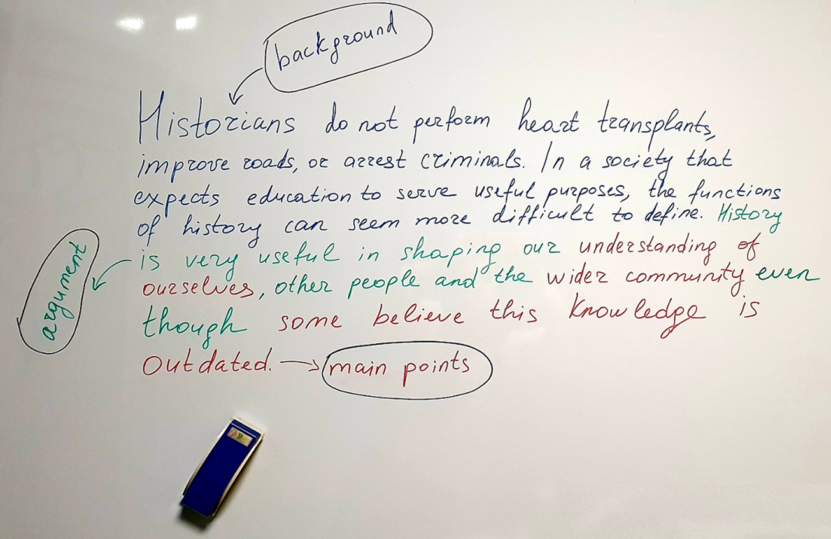
AVOID GENERALIZATIONS, CLICHÉS, QUESTIONS, OR “STATING THE OBVIOUS”:
Pollution is bad for the environment.
Homelessness is a problem
Should the Federal Reserve reduce the federal funds rate?
The future looks bright for companies developing vaccines

Slide 11
Tips for Writing a Good Argumentative Essay
#1: Make Your Thesis Clear
Thesis is the key to the argumentative essay; if it isn’t clear or readers can’t find it easily, your entire essay will be weak. The typical spot for it is the final sentence of the introduction paragraph, but if it doesn’t fit , try to at least put it as the first or last sentence of a different paragraph so it stands out more. Also make sure that your thesis makes clear what side of the argument you’re on.
#2: Show Why the Other Side Is Weak
Do not be tempted to ignore the other side of the argument and just focus on your side.
Before you begin writing, research what the other side believes, and what their strongest points are. in your essay, be sure to mention each of these and use evidence to explain why they’re incorrect/weak arguments.
#3: Use Evidence to Support Your Side
an essay can’t be an argumentative essay if it doesn’t support its argument with evidence. For every point you make, make sure you have facts to back it up. Some examples are previous studies done on the topic, surveys of large groups of people, data points, etc. This will make your essay much stronger than relying on your own opinions to support your argument.
Notes:
Argumentative essays are persuasive essays that use facts and evidence to support their side of the argument.
By reading good argumentative essay examples, you can learn how to develop your essay and provide enough support to make readers agree with your opinion.
When writing your essay, remember to always make your thesis clear, show where the other side is weak, and back up your opinion with data and evidence.

Slide 12
Sample Essay
As online learning becomes more common and more and more resources are converted to digital form, some people have suggested that public libraries should be shut down and, in their place, everyone should be given an iPad with an e-reader subscription.
Proponents of this idea state that it will save local cities and towns money because libraries are expensive to maintain. They also believe it will encourage more people to read because they won’t have to travel to a library to get a book; they can simply click on what they want to read and read it from wherever they are. They could also access more materials because libraries won’t have to buy physical copies of books; they can simply rent out as many digital copies as they need.
Notes:
The author begins by giving an overview of the counter-argument, then the thesis appears as the first sentence in the third paragraph.
The essay then spends the rest of the paper dismantling the counter argument and showing why readers should believe the other side.

Slide 13
However, it would be a serious mistake to replace libraries with tablets. First, digital books and resources are associated with less learning and more problems than print resources. A study done on tablet vs book reading found that people read 20-30% slower on tablets, retain 20% less information, and understand 10% less of what they read compared to people who read the same information in print. Additionally, staring too long at a screen has been shown to cause numerous health problems, including blurred vision, dizziness, dry eyes, headaches, and eye strain, at much higher instances than reading print does. People who use tablets and mobile devices excessively also have a higher incidence of more serious health issues such as fibromyalgia, shoulder and back pain, carpal tunnel syndrome, and muscle strain. I know that whenever I read from my e-reader for too long, my eyes begin to feel tired and my neck hurts. We should not add to these problems by giving people, especially young people, more reasons to look at screens.

Slide 14
Essay Writing Task:
Occasionally, students in elementary school are allowed to advance to the next grade even though they have not successfully completed the lower grade. Advocates of “social promotion” think that keeping a child in a grade for longer than a year hurts his or her development and self-esteem. Write an essay stating your opinion on this issue, making sure to support your opinion with convincing reasons.
A well-known football coach once said, "Winning isn't everything, it's the only thing." Do you agree or disagree? Write an essay in which you state your position and support it with convincing reasons.
One of the great temptations of the digital age is stealing intellectual property via the Internet. In your essay, analyse the phenomenon of plagiarism in the digital age.
Your essay should be well-structured and supported by relevant evidence and examples.
Notes:
Hook -Not all thieves lurk in dark alleys and parks; some sit with their faces lit by the glow of their computer monitors, copying, pasting, and printing.
Thesis- The Internet has raised the theft of "intellectual property" to a new level, yet many students remain unaware of the exact definition of plagiarism and its consequences.“

